Slide 1

SHORT IRON CONDOR STRATEGY On Infosys Ltd Stock
Presented by
Sec-a Group 7

Slide 2


Project & Strategy Introduction
The Short Iron Condor is an options trading strategy that involves both a call spread and a put spread with the same expiration date but different strike prices.
- Sell a lower strike put and buy a further lower strike put (bull put spread).
( Selling Put at strike of 1860 lower than spot of 1880 and buying a put further low at 1820)
- Sell a higher strike call and buy a further higher strike call (bear call spread).
(Selling call at 1900 above sport of 1880 and buying a call further above at 1940)
Schwab, C. (n.d.). Iron condor strategy: Limited risk, limited reward. Charles Schwab. https://www.schwab.com/resource-center/insights/content/iron-condor-strategy-limited-risk-limited-reward
Project Finance. (n.d.). Iron condor options strategy. Project Finance. https://www.projectfinance.com/iron-condor-options-strategy/
Theta Trend. (n.d.). How to trade the iron condor options strategy. Theta Trend. https://www.thetatrend.com/iron-condor-options-strategy/

Slide 3

Market Scenario Suitable for SIC Strategy
It is used When a trader expects the underlying asset to remain within a specific price range (low volatility).
Profit Scenario:
The maximum profit occurs if the asset's price stays between the strike prices of the sold call and put at expiration.
(Hence if Market price of Infosys remains btw 1860 and 1900 at Expiration).
Risk Scenario:
The maximum loss occurs if the price of the underlying asset moves significantly beyond either the upper or lower strikes, leading to one of the spreads being fully exercised. (i.e. if price goes beyond 1940 or below 1820)
As on 13-09-2024 : Infosys Stock Price – Infosys Stock Price was at Rs 1,944/- which is above 1940 and hence we are making losses.
Schwab, C. (n.d.). Iron condor strategy: Limited risk, limited reward. Charles Schwab. https://www.schwab.com/resource-center/insights/content/iron-condor-strategy-limited-risk-limited-reward
Project Finance. (n.d.). Iron condor options strategy. Project Finance. https://www.projectfinance.com/iron-condor-options-strategy/
Theta Trend. (n.d.). How to trade the iron condor options strategy. Theta Trend. https://www.thetatrend.com/iron-condor-options-strategy/

Slide 4
Suitability of SIC to ‘Infosys’ -Open Interest
Strike Price | Calls OI | Puts OI
1820 | 135 | 560
1840 | 488 | 1032
1860 | 311 | 1486
1880 | 347 | 1509
1900 | 1374 | 3538
1920 | 1885 | 1817
1940 | 5724 | 2020
Relatively high OI for put at 1900 (Max profit making zone) indicate bearish sentiment and implies price might stay around 1900 )
Relatively high OI for call above the max profit making zone indicates resistance above 1900
Hence SIC strategy is suitable for INFOSYS Stock based on Open Interest.

Slide 5

Avg Stock price movement in Infosys Ltd
Average Price Movement (Aug 22 - Sep 13):
Range: The stock price was ₹1,880 on August 22, and it closed at ₹1,948.85 on September 13.
Average Price (VWAP - Volume Weighted Average Price ):
Overall Average= 1,918.50
The Infosys Underlying stock has on an average has been above 1900 which is the max profit range and close to 1940 beyond which we enter max losses zone.
It turned out that this strategy didn’t suit Infosys much based on actual price movements in the underlying stocks.
Schwab, C. (n.d.). Iron condor strategy: Limited risk, limited reward. Charles Schwab. https://www.schwab.com/resource-center/insights/content/iron-condor-strategy-limited-risk-limited-reward
Project Finance. (n.d.). Iron condor options strategy. Project Finance. https://www.projectfinance.com/iron-condor-options-strategy/
Theta Trend. (n.d.). How to trade the iron condor options strategy. Theta Trend. https://www.thetatrend.com/iron-condor-options-strategy/

Slide 6
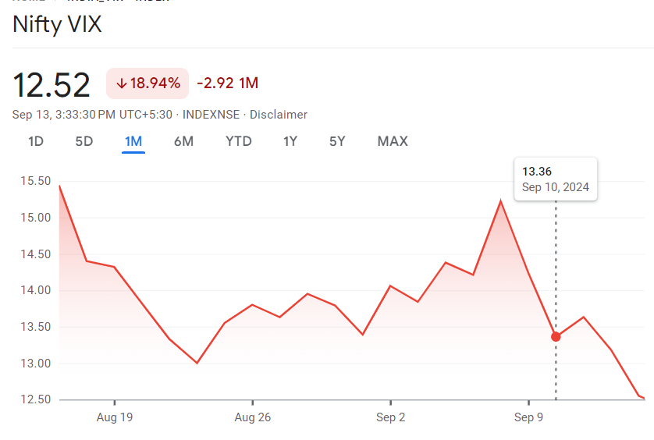
Effect of NIFTY VIX on SIC-Infosys Ltd
Nifty VIX on 22 Aug 2024
13.00
NIFTY VIX ON 13 Sept 2024
12.52
Change
-3.69%
Interpretation:
A fall in NIFTY VIX suggests a decrease in market volatility, which can be advantageous for short iron condor strategy as it lowers the chances of extreme price movements.
Benzinga. (n.d.). How to trade VIX options: A step-by-step guide. Benzinga. https://www.benzinga.com
TradingSim. (n.d.). Mastering the art of shorting the VIX: Strategies for volatility trading. TradingSim. https://www.tradingsim.com
White, C. (2019). VIX trading strategies: Techniques to profit from volatility. Wiley Publishing.

Slide 7
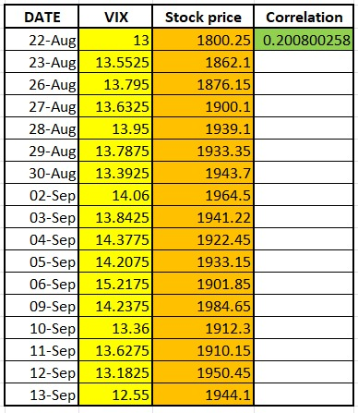
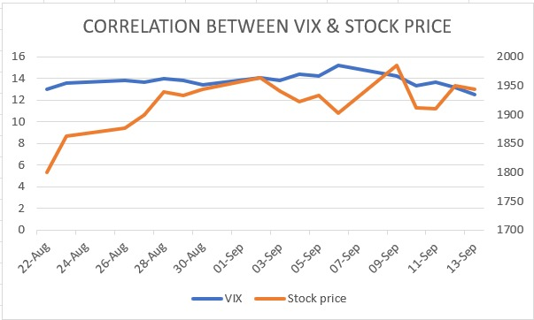
The correlation value of 0.2008 indicates a weak positive correlation between the Nifty VIX and Infosys's stock price during the specified period. This means that, to some extent, when the VIX increases, Infosys’s stock price tends to increase, though not strongly.
TradingSim. (n.d.). Mastering the art of shorting the VIX: Strategies for volatility trading. TradingSim. https://www.tradingsim.com
White, C. (2019). VIX trading strategies: Techniques to profit from volatility. Wiley Publishing.

Slide 8
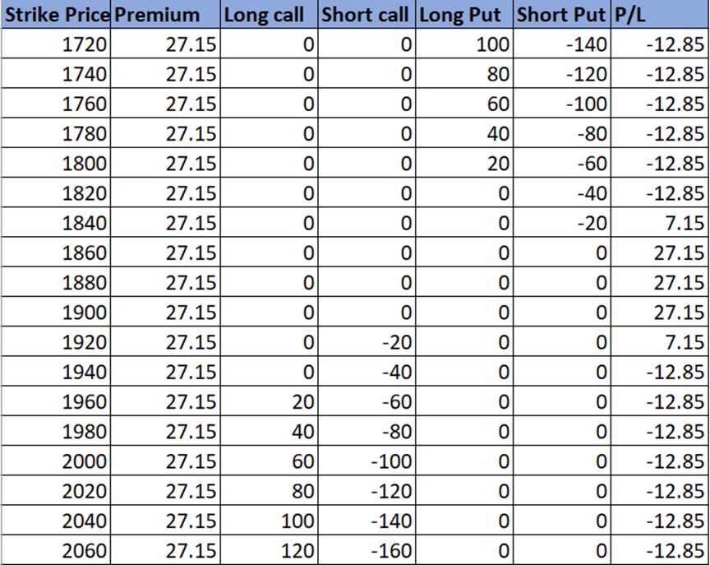
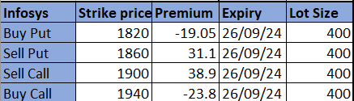

Short Iron Condor Payoff Table
Entry on 22nd Aug 2024
Kalyanasundaram, S. (2024). Options trading strategies and volatility [Class notes]. IFMR Graduate School of Business. (Personal communication).

Slide 9
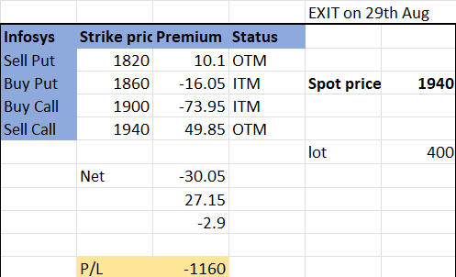
Payoff Diagram
If Squared off on 29-08-2024 (After 1 Week)
Kalyanasundaram, S. (2024). Options trading strategies and volatility [Class notes]. IFMR Graduate School of Business.

Slide 10
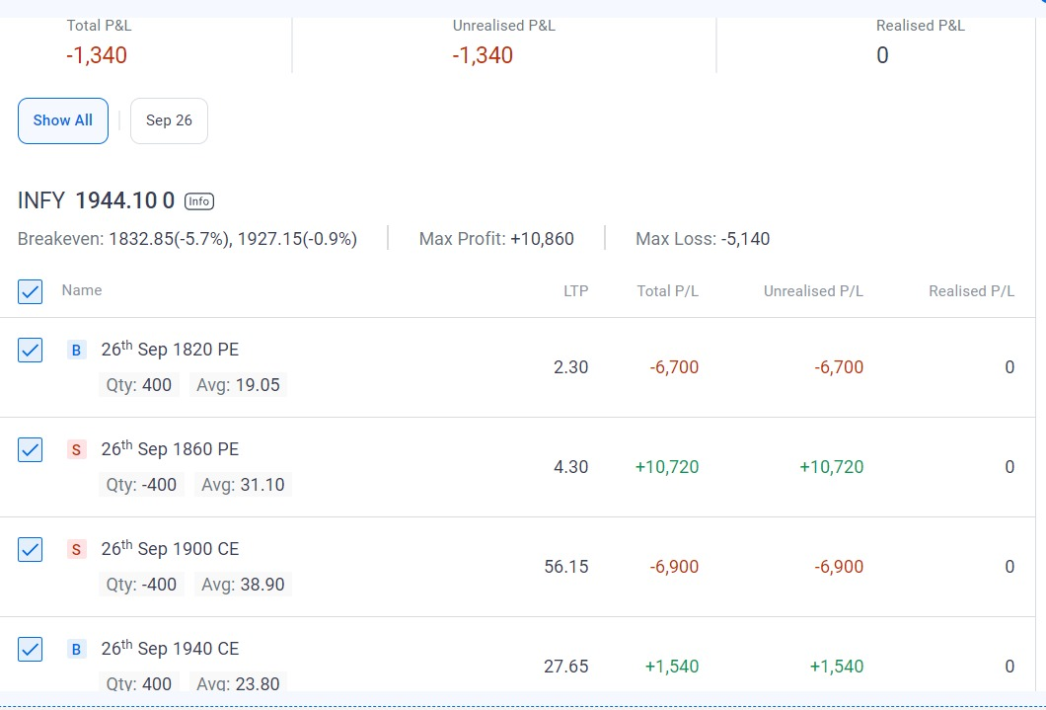
If Squared off on 13-09-2024 (After 3 Weeks) ?

Slide 11
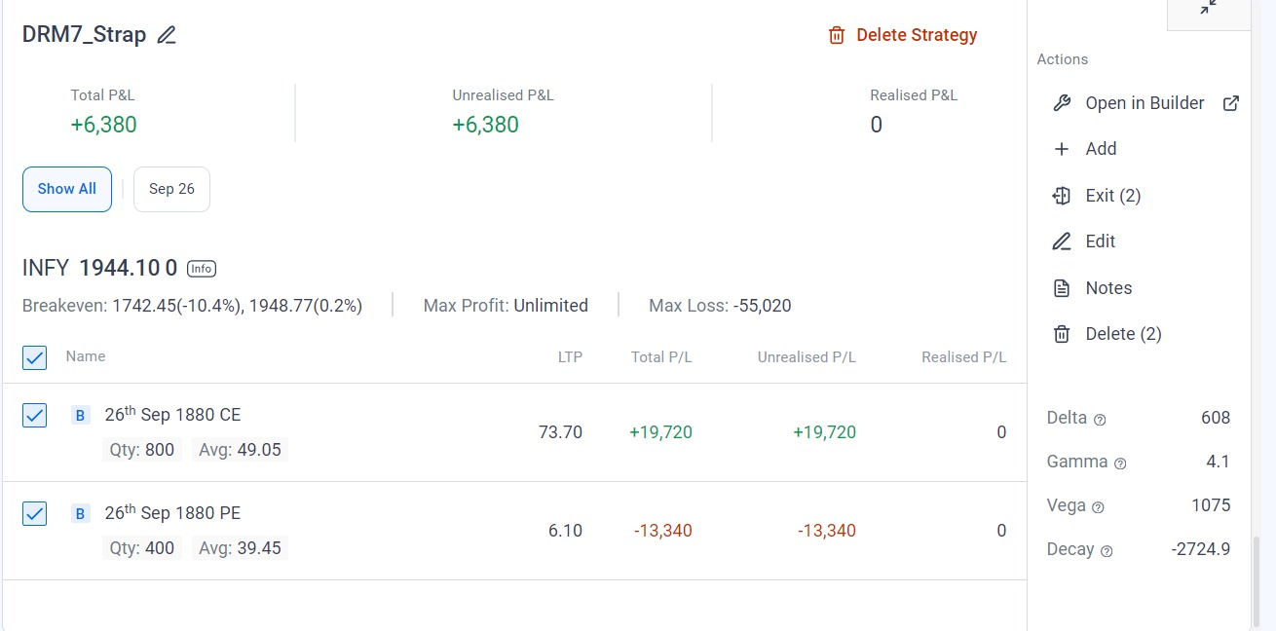
Alternative Strategies Used
Strap strategy
- Buy call ATM at 1880
- Buy put ATM at 1880
Profit = + 6,380

Slide 12

Strap strategy on Infosys Stock
The strap strategy benefits from significant price movement in either direction, with a bias towards the upside.
Call Option (ATM 1880): The call option have gained in value since the stock price has moved above the strike price. The profit from this position increases as the stock price rises.
Put Option (ATM 1880): The put option will have decreased in value, as it is now out-of-the-money. However, the loss from this put option is limited to the premium paid. Construction: Buy 2 call options (ATM 1880)
Buy 1 put option (ATM 1880)
Overall, because the stock price has moved significantly up (1880 to 1944), the gain from the call option will outweigh the loss from the put option, leading to a net profit from this strategy.
Kalyanasundaram, S. (2024). Options trading strategies and volatility [Class notes]. IFMR Graduate School of Business.

Slide 13
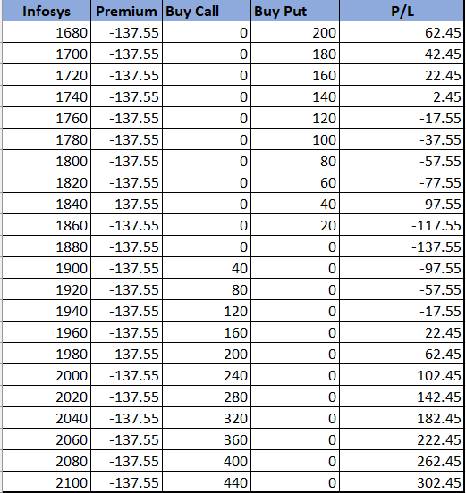
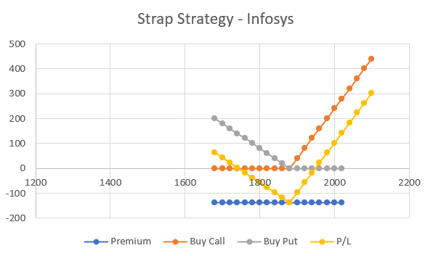

Kalyanasundaram, S. (2024). Options trading strategies and volatility [Class notes]. IFMR Graduate School of Business.

Slide 14
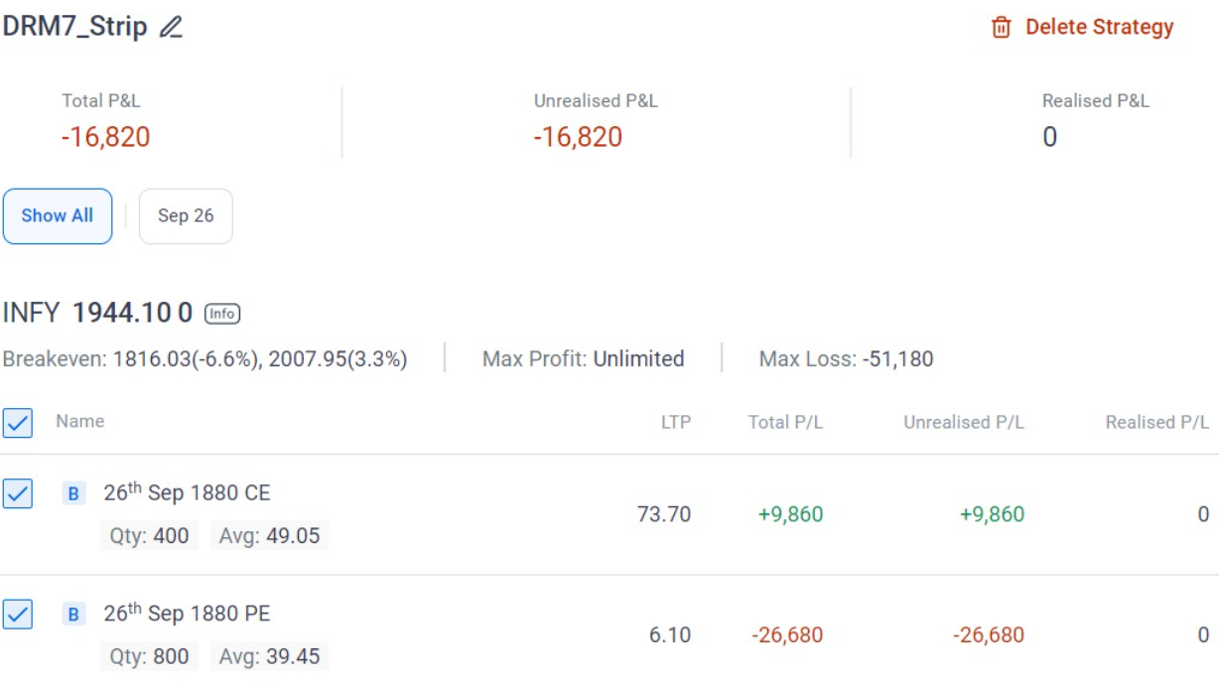
Strip strategy on Infosys Stock
The strip strategy benefits from significant price movement in either direction, with a bias towards the downside.
Put Option (ATM 1880): The put options have decreased in value since the stock price has moved above the strike price. The loss from these positions increases as the stock price rises.
Call Option (ATM 1880): The call option will have gained in value, as it is now in-the-money. However, the profit from this call option is limited because of the lower number of call options compared to the puts in this strategy.
Construction: Buy 1 call option (ATM 1880)
Buy 2 put options (ATM 1880)
Overall, because the stock price has moved significantly up(1880 to 1944), the loss from the put option will outweigh the profit from the call option, leading to a net loss from this strategy.
Kalyanasundaram, S. (2024). Options trading strategies and volatility [Class notes]. IFMR Graduate School of Business.

Slide 15


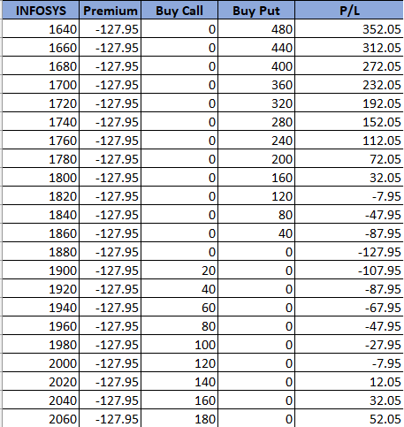
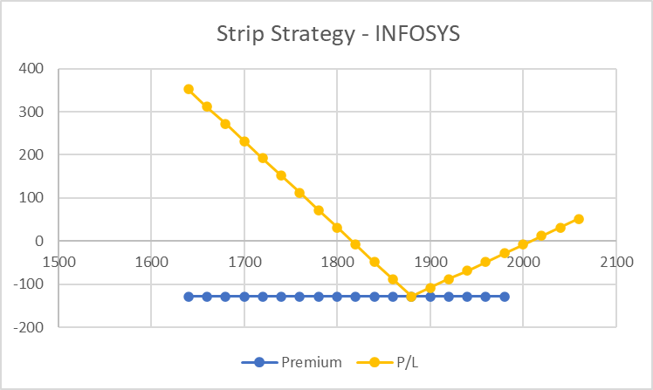
Kalyanasundaram, S. (2024). Options trading strategies and volatility [Class notes]. IFMR Graduate School of Business.

Slide 16
Conclusion
Short Iron Condor strategy is suitable when the underlying asset price is expected to remain within a given upper and lower range.
In our case the strategy would have yielded high profits if the Infosys stock price remained between 1860 and 1900
If the price had went below 1820 or risen above 1940, this strategy would have given losses
As the actual price went above 1940 we made losses.
On the other hand, Strap strategy worked in our favor since the increase in underlying asset price the call value raised significantly when the loss on put was limited to the premium hence we made profits.
Net Profits: 6,380-1,340 = Rs 5,040 /-
(As On 13-09-2024)
Schwab, C. (n.d.). Iron condor strategy: Limited risk, limited reward. Charles Schwab. https://www.schwab.com/resource-center/insights/content/iron-condor-strategy-limited-risk-limited-reward
Project Finance. (n.d.). Iron condor options strategy. Project Finance. https://www.projectfinance.com/iron-condor-options-strategy/
Theta Trend. (n.d.). How to trade the iron condor options strategy. Theta Trend. https://www.thetatrend.com/iron-condor-options-strategy/

